Slide 1
What are the priorities we need to start on now to ensure best integration of high renewables?
1

Slide 2
With increasing wind/solar, each addition displaces less expensive generation. How big an economic factor is the declining displaced value?
How important is geographic diversity of renewable resources?
What insights have studies given on Curtailment and Overgeneration?
What Operational Practices most impact integration of wind and solar? How much could changing institutional barriers help?
Is there enough physical flexibility in existing/projected future systems?
What are the overall cost impacts of RE futures?
2

Slide 3
With increasing wind/solar, each addition displaces less expensive generation. How big an economic factor is the declining displaced value?
  Capacity and energy value changes?
  Does ancillary service value increase?
  Gas price sensitivity?
3

Slide 4
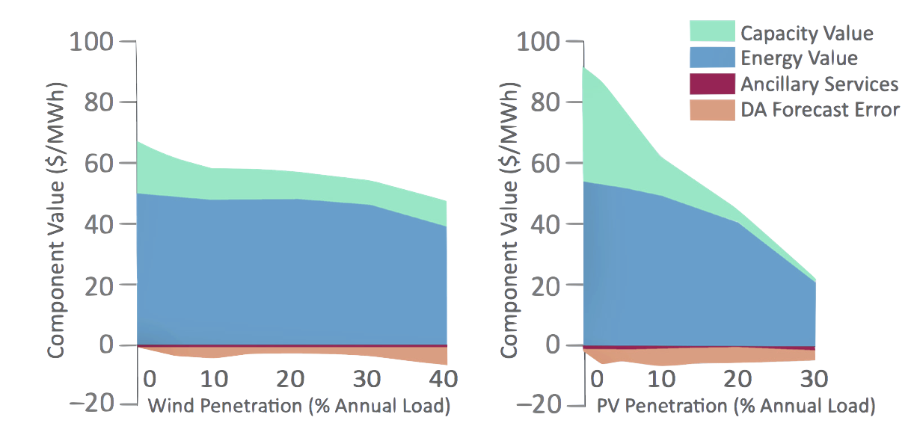
Decline in Economic Value Primarily Driven by Decreases in Capacity and Energy Value
Wind
PV
We examine causes in the decline in the marginal economic value. The primary factors are decreases in energy value (which fuels were displaced) and capacity value (how much conventional capacity was avoided).
Costs due to operational factors (day-ahead forecast errors and ancillary services) do not increase as much with penetration.
(Mills and Wiser 2012)
Notes:
The short term operational issues are not the only challenge.
We’ve done some work looking at the economic value of wind and solar at higher penetration levels.
We see that a big source of value for solar is its ability to displace the need to build conventional generation (the capacity value).
With increasing penetration, that capacity value declines.
Similarly PV starts to displace lower and lower cost fuels, eventually being curtailed, thereby lowering the energy value.
Continuing to deploy PV on requires continued PV cost reductions.

Slide 5
  How important is geographic diversity of renewable resources?
    How much “sloshing” could we see in the Western Interconnect?
    How would the RE technology mix factor in?
    How would future flows compare to current transmission usage?
    What kind of impacts could we see on coal WECC wide?
5

Slide 6
Low Carbon Grid Study
Carbon Emission Trajectories
CARB emissions trajectory to 2050
Baseline Case results
Target Case- Enhanced
Target-Conventional
Accelerated Case (Phase I)

Slide 7
Low Carbon Grid Study
Steepest Ramp Day (Winter)
Net Load - Imports
Target- Enhanced
High Solar- Conventional

Slide 8
Geographic Diversity Increases the Value of Wind By Reducing Frequency of Extremes
Gray dots represent wind sites used in Reference Case with 40% Wind
Geographic diversity of wind locations was increased by siting wind to minimize the variance of the aggregated wind output. Higher diversity reduces time when wind is generating during low prices and wind curtailment, thereby increasing the energy value of wind.

Slide 9
Wind in the east, solar in the south
Gas CCS deployed mostly in California
Pacific Northwest hydro not readily available to California
Wind sent westward towards coast

Slide 10
Transmission built to bring renewables toward coast
Remote wind is a key driver
Long distances and high power → DC lines?

Slide 11
What insights have studies given on Curtailment and Overgeneration?
  What Export/Import issues are raised?
  What changes could be realized by treating wind/solar as Dispatchable?
  How much does using the grid service capabilities of wind/solar change curtailment?
What Operational Practices most impact integration of wind and solar? How much could changing institutional barriers help? For example:
  Unit commitment and dispatch time frames
  Local minimum generation (reliability proxies)
  Current must take contract limits
  REC locational impacts (Bucket rule)
11

Slide 12
Curtailment
Wind
PV

Slide 13
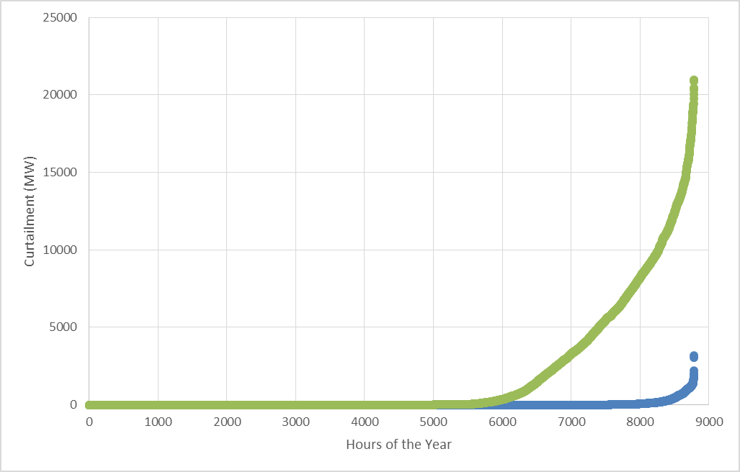
Low Carbon Grid Study
Curtailment of Renewable Energy
A: 55% renewables, conventional flexibility
case:
Solar PV dominates new procurement
No additional bulk storage
Continuation of today’s
operation policies
B: 55% renewables, enhanced flexibility case:
Balanced portfolio
Additional bulk storage
Economically rational imports and exports
Renewables allowed to provide essential reliability services and flexibility
Difference in Cases: B minus A
CA Cost savings: $1.1 B/yr
CA Carbon saved: 5 MMT/year
Rest of WECC carbon saved: 2.5MMT/yr

Slide 14
Low Carbon Grid Study
Results Summary
Case | Net Cost (% of RevReq) | CA Carbon (MMT/yr) | RE Curtailment (%)
Diverse/Enhanced | 0.6% | 41.1 | 0.2%
High Solar/Enhanced | 2.2% | 42.2 | 0.5%
Diverse/Conventional | 2.3% | 45.0 | 4.2%
High Solar/Conventional | 4.1% | 46.8 | 9.7%

Slide 15
Operating renewables flexibly is particularly effective
Curtailment: nimble is much better than blocky
4.8
2.7
50% RPS Base

Slide 16
Essential reliability services needed in grid operations
[But some reliability requirements cause curtailment at a 50% RPS]
Load Following
and Regulation
DOWN

Slide 17
Low Carbon Grid Study
Steepest Ramp Day Dispatch (Winter)

Slide 18
Low Carbon Grid Study
Steepest Ramp Day (Winter)
Net Load: Load - Renewables
Target- Enhanced
High Solar- Conventional

Slide 19
Low Carbon Grid Study
Steepest Ramp Day (Winter)
Net Load - Imports
Target- Enhanced
High Solar- Conventional

Slide 20
Low Carbon Grid Study
Steepest Ramp Day (Winter)
Net Load – Imports - Storage
Target- Enhanced
High Solar- Conventional

Slide 21
Low Carbon Grid Study
Steepest Ramp Day (Winter)
Net Load – Imports – Storage - DR
Target- Enhanced
High Solar- Conventional

Slide 22
Low Carbon Grid Study
Steepest Ramp Day (Winter)
Net Load – Imports – Storage – DR- Hydro
Target- Enhanced
High Solar- Conventional

Slide 23
Low Carbon Grid Study
Steepest Ramp Day (Winter)
Curtailment:
Net Load – Imports – Storage – DR – Hydro - Gas
Target- Enhanced
High Solar- Conventional

Slide 24
5. Is there enough physical flexibility in existing/ projected future systems?
  What limitations exist for using those capabilities?
  What kind of flexibility is most valuable and needed?
  What is the Value of adding more flexible gas generation?
24

Slide 25
Gas power plant flexibility has important limits
Providing some reliability services with gas requires electricity production, which “crowds out” renewables
Gas fleet changes in the Flexible Gas run:
Double ramp rate
Half minimum power level
1 hour start and stop times
2 hour minimum uptime and downtime
Duck Curve: “belly” is much more important than the “neck”
Notes:
Slide 6: “Concept: “net” electricity demand”
The operators of our electricity system have a difficult job. They have to provide power exactly when, where, and in whatever magnitude millions of end user are demanding power. They do so by changing the output of power plants that are already on, and--for bigger swings in demand--turning power plants on and off.
We can’t control the wind or the sun, so the system operator doesn’t have control over these power plants in their decision-making process. They are therefore concerned about “net” electricity demand, which is the power demand MINUS wind and solar production. The result of this calculation is the electricity demand that the system operator must supply in order to keep the system operational.

Slide 26
Renewable flexibility competes with gas flexibility
When renewables can provide reserves, the amount of operational flexibility on the grid increases. Consequently, the amount of curtailment that can be avoided by increasing the flexibility of natural gas power plants decreases
Notes:
Slide 6: “Concept: “net” electricity demand”
The operators of our electricity system have a difficult job. They have to provide power exactly when, where, and in whatever magnitude millions of end user are demanding power. They do so by changing the output of power plants that are already on, and--for bigger swings in demand--turning power plants on and off.
We can’t control the wind or the sun, so the system operator doesn’t have control over these power plants in their decision-making process. They are therefore concerned about “net” electricity demand, which is the power demand MINUS wind and solar production. The result of this calculation is the electricity demand that the system operator must supply in order to keep the system operational.

Slide 27
Reserves from non-fossil resources are valuable
37%
56%
67%
75%
% Non-Fossil
Upward
Downward
Downward reserves are particularly valuable
Notes:
Slide 6: “Concept: “net” electricity demand”
The operators of our electricity system have a difficult job. They have to provide power exactly when, where, and in whatever magnitude millions of end user are demanding power. They do so by changing the output of power plants that are already on, and--for bigger swings in demand--turning power plants on and off.
We can’t control the wind or the sun, so the system operator doesn’t have control over these power plants in their decision-making process. They are therefore concerned about “net” electricity demand, which is the power demand MINUS wind and solar production. The result of this calculation is the electricity demand that the system operator must supply in order to keep the system operational.

Slide 28
6. What are the overall cost impacts of RE futures:
  Capital cost vs. production cost (fuel) savings?
  Ancillary services needed for a high VER future?
28

Slide 29
Low Carbon Grid Study
Results Summary
Case | Net Cost (% of RevReq) | CA Carbon (MMT/yr) | RE Curtailment (%)
Diverse/Enhanced | 0.6% | 41.1 | 0.2%
High Solar/Enhanced | 2.2% | 42.2 | 0.5%
Diverse/Conventional | 2.3% | 45.0 | 4.2%
High Solar/Conventional | 4.1% | 46.8 | 9.7%

Slide 30
What are the priorities we need to start on now to ensure best integration of high renewables?
  What improvements could markets facilitate?
  Does it make sense to focus first on market expansion, then on market improvement? Or, are there key institutional practices and barriers that should be addressed now?
  How do we ensure adequate grid services? How should they be valued and compensated for?
  What about different considerations for distributed energy resources?
  What policy priorities can support improved integration?
30

Slide 31
  What improvements could markets facilitate?
    More efficient procurement of various types of flexibility and reliability services from a large set of technologies. Currently missing from markets: contingency response below one minute (primary frequency response and inertia), day-ahead load following/ramping
  Does it make sense to focus first on market expansion, then on market improvement? Or, are there key institutional practices and barriers that should be addressed now?
  Can’t afford to wait – need to do both at the same time.
  3. How do we ensure adequate grid services? How should they be valued and compensated for?
    Hard to beat technology-neutral electricity markets with a reasonable carbon price for proper valuation and compensation in operations. In planning and procurement, need to consider many value streams simultaneously… don’t just focus on resource adequacy capacity when a resource could also provide a lot of energy and/or other grid services.
  4. What about different considerations for distributed energy resources?
    Locational value in the transmission system should be explored. Can smart inverters on distributed systems in the right parts of the grid (example: LA Basin) increase transmission system flexibility? Decrease local conventional generation needs?
  5. What policy priorities can support improved integration?
    Ensuring that most if not all new renewable ship with active power controls, and have contracts that allow for not only curtailment but also ancillary services. Clear policy support for demand response providing ancillary services would be helpful as well.

Slide 33
Studies of high percentage RE cleaner electricity futures have consistent overall messages and frameworks:
High penetrations of wind/solar are compatible with a reliable grid at reasonable cost.
  PotAnalysis of issues is not simple or quick. Selection of tools, data, and assumptions are critical to ensuring valid and insightful results. Technical review by experts in a transparent fashion is important.
  ential impacts are system specific, and need careful evaluation
  “with good engineering and planning…”
Business as Usual is not sufficient to move rapidly toward cleaner grid futures
  Historic procedures and practices were not designed with VER characteristics in mind
Three main areas of Reliability must be considered:
  Resource adequacy and planning
  Normal grid operations and load/generation balancing
  Disturbance and contingency loss response

Slide 34
Make the best use of what you have got
  Use the physical capabilities that already exist in the system
    Conventional Generators: flexibility from gas, hydro
    Transmission: not contract/ownership limited
  Institutional constraints may limit access to capabilities
  Enhance existing capabilities when cost effective
    Minimum downturn, ramp rates, on/off cycling times
    Opportunities with gas, coal, pumped and conventional hydro
    Coal to Synchronous condenser conversions
Broader geographic footprints and Shorter time frames are very valuable (Milligan Sumo Wrestler Grid analogy – Big and Fast)
  Markets, bigger BA’s, and other grid cooperation measures for geographic diversity (load, Renewable resources), reserve pooling, forecast error reduction
  Shorter commitment and dispatch intervals reduce forecast errors, minimize reserve needs
  Communication and coordination needs may require reform and investments
Recognize non-traditional capabilities and sources of services
  Demand management, VER/inverter based Renewables, Storage, Distributed resources
  Enhanced capabilities of new gas plants: modular, fast ramp, fast cycling, staged simple cycle/combined cycle, clutch for synchronous condenser operations
  Inverter based VER can provide
    primary response (inertia and fast governor response)
    Voltage and VAR regulation and support
    Frequency and voltage excursion ride-thru
    Secondary response and regulation services

Slide 35
References
Mills, A.D., A. Botterud, J. Wu, Z. Zhou, B. M. Hodge, and M. Heaney. 2013. Integrating Solar PV in Utility System Operations. ANL/DIS-13/18. Argonne, IL: Argonne National Laboratory. http://www.osti.gov/scitech/biblio/1107495.
Mills, A.D., and R. Wiser. 2010. Implications of Wide-Area Geographic Diversity for Short-Term Variability of Solar Power. LBNL-3884E. Berkeley, CA: Lawrence Berkeley National Laboratory. http://emp.lbl.gov/sites/all/files/REPORT%20lbnl-3884e.pdf.
Luckow, P., T. Vitolo, and J. Daniel. 2015. A Solved Problem: Existing Measures Provide Low-Cost Wind and Solar Integration. Cambridge, MA: Synapse Energy Economics, Inc. http://synapse-energy.com/sites/default/files/A-Solved-Problem-15-088.pdf.
Nelson, J.H., and L.M. Wisland. 2015. Achieving 50 Percent Renewable Electricity In California. Union of Concerned Scientists. http://www.ucsusa.org/sites/default/files/attach/2015/08/Achieving-50-Percent-Renewable-Electricity-In-California.pdf.
Mills, A.D., and R. Wiser. 2012. Changes in the Economic Value of Variable Generation with Increasing Penetration Levels: A Pilot Case Study of California. LBNL-5445E. Berkeley, CA: Lawrence Berkeley National Laboratory. http://emp.lbl.gov/sites/all/files/lbnl-5445e.pdf.
Mills, A.D., and R. Wiser. 2014. Strategies for Mitigating the Reduction in Economic Value of Variable Generation with Increasing Penetration Levels. LBNL-6590E. Berkeley, CA: Lawrence Berkeley National Laboratory. http://emp.lbl.gov/sites/all/files/lbnl-6590e.pdf.

